Slide 1

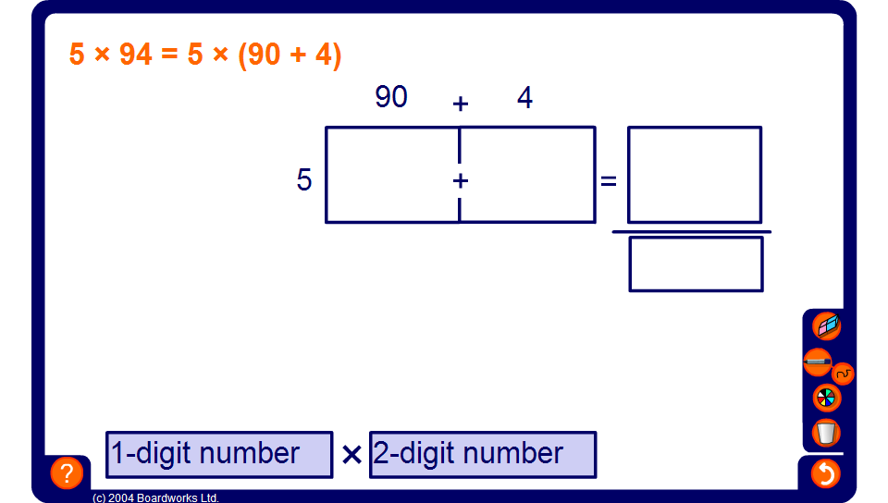


Grid method for multiplying numbers
Notes:
Use this slide to review the grid method for multiplying two numbers.

